Slide 1
Data Analytics Programming
Deepayan Chakrabarti (deepay@utexas.edu)
Notes:
It’s only now that we have so much data available that analysis is feasible for many problems
Data analysis is often an iterative process. Hard parts: (a) even figuring out what is the right question, or the right place to look (b) which standard tool is most relevant, and what to do when it fails? (c) a business problem is not the same as just a technical problem
Why should a manager care?
Good technical analysts are rare, and expensive, and will not enjoy being asked to do trivial analyses
Being able to program and actually do the analysis is a hard skill ➔ differentiator in the job market

Slide 2
What’s this about?
Big Data
Insights
… is where all the buzz is.
Who “liked” what posts?
Who friended/followed whom?
Who clicked on what news stories?
How do we improve News Feed?
How can we only show relevant ads?
How do we help people find their friends online?
… where the money is.
Notes:
Say, for a company like Facebook where I worked. Communication patterns; who messaged whom? How often? When? In a group or not? Logged in on Android, iPhone, or desktop?
Insights = actionable items.

Slide 3
What’s this about?
Big Data
Insights
That line is tangled
“Big”
but it isn’t really about how many data centers the company has
How is the data I have is related to the insights I want?
Notes:
Making anything scale to a very large dataset is a problem. Often a significant problem. But it’s not just about throwing more computers at it. It isn’t really about how many data centers the company has.

Slide 4
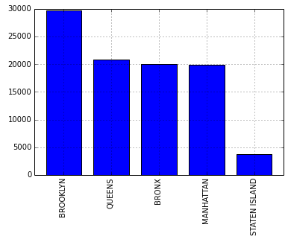
What’s this about?
Big Data
Insights
How is the data I have is related to the insights I want?
“How should I distribute law enforcement units throughout New York?”
Look at the number of complaints from each Borough

Slide 5
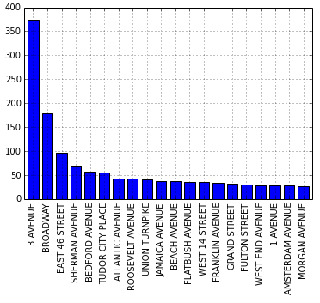
What’s this about?
Big Data
Insights
How is the data I have is related to the insights I want?
“I’m visiting New York and I hate noise. What should I avoid?”
Aggregate noise complaints around each street

Slide 6
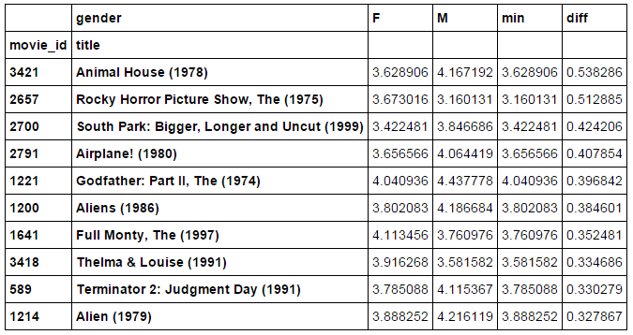
What’s this about?
Big Data
Insights
How is the data I have is related to the insights I want?
“What movies are rated very differently by men and women?”

Slide 7
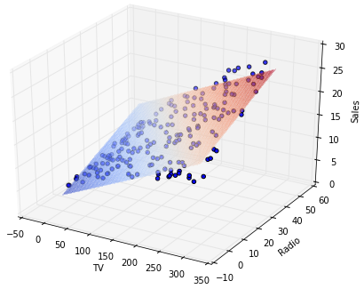
What’s this about?
Big Data
Insights
How is the data I have is related to the insights I want?
“How is advertising on TV, Radio, and Newspapers related to sales?”
TV and Radio matter, Newspapers not at all (!)

Slide 8
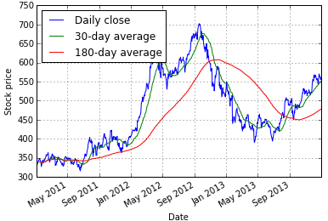
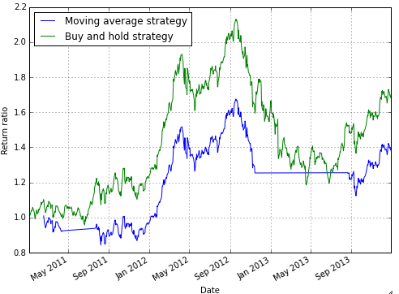
What’s this about?
Big Data
Insights
How is the data I have is related to the insights I want?
“How well does a trading strategy work?”

Slide 9
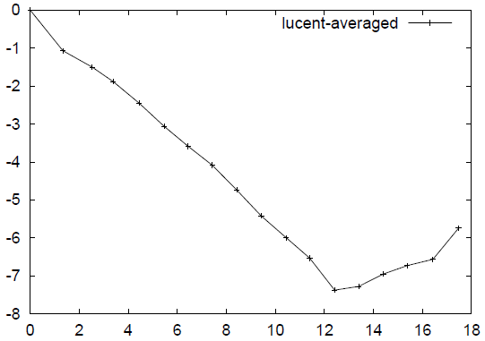
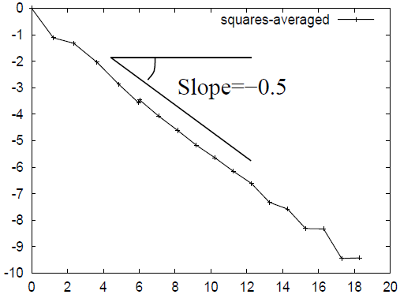
What’s this about?
Big Data
Insights
How is the data I have is related to the insights I want?
“Does the data look right?”
(Expected plot)
Is this strange?
Notes:
What subsets of the data are interesting? Are there strange correlations? What are the right attributes of the data to consider? Age/Gender defines news feed behavior? Or mobile/desktop as well? Country? Get plots of the data, see if something is amiss…
Does the data look right? ➔ Not just plotting the data, but also some knowledge or experience of how things _should_ look.

Slide 10
What’s this about?
Big Data
Insights
How is the data I have is related to the insights I want?
Exploratory data analysis
“Does the data look right?”
“How do we analyze relationships between variables?”
“How does the data change depending on user groups?”
Leads to a concrete problem
(asking the right questions)

Slide 11
What’s this about?
Big Data
Insights
How is the data I have is related to the insights I want?
Exploratory data analysis
“Does the data look right?”
Concrete problem
“Deliver a better experience to some subset of customers.”
Example: “Important posts from friends are swamped out by cat pictures and random memes on News Feed”
How do you fix this?
Notes:
Advertisers of computer tech support are getting swamped out by ads from computer manufacturers. How do you fix this?
(2) Memes in News Feed. How do you fix News Feed? Identify cat pictures. Classify post a meme or not…

Slide 12
What’s this about?
Big Data
Insights
How is the data I have is related to the insights I want?
Get the data
From websites
From APIs
(never quite in the form we need)
Notes:
Twitter, Instagram and others have APIs for Python.

Slide 13
What’s this about?
Big Data
Insights
How is the data I have is related to the insights I want?
Get the data
Munge it into shape (“data wrangling”)
Remove mistaken entries
Fill in missing values
Example: Text analysis
remove stop-words (“a”, “an”, “the”, “she”)
stem remaining words (“car” and “cars” are the same)
merge synonyms?

Slide 14
What’s this about?
Big Data
Insights
How is the data I have is related to the insights I want?
Get the data
Munge it into shape (“data wrangling”)
Visualization
Drill-downs into the data
Look at specific groups within the data
“How does the Facebook user experience differ based on the number of friends?”
Notes:
Drill-down ➔ look at specific groups within the data

Slide 15
What’s this about?
Big Data
Insights
How is the data I have is related to the insights I want?
Get the data
Munge it into shape (“data wrangling”)
Visualization
Drill-downs into the data
Specific analysis techniques
Classification: “which customers are likely to switch to a competitor?”
Clustering: “how can I group customers by their behavior?”
Notes:
Classification: churn prediction for mobile operators, recommending books, or movies.
Clustering: Groups of users to advertise to (e.g., sharing a certain interest)

Slide 16
What’s this about?
Big Data
Insights
That tangled line hides a lot of complexity
This course is about
(primarily) the tools to work with data and do the analysis
(secondarily) gaining a working knowledge of the tool internals
Specifically, data analysis with Python

Slide 17
Why Python?
Indeed, many possibilities
R
really good for statistical analyses
Matlab
really good optimization and other toolkits
preferred by many machine learning and signal processing researchers
C and C++
general-purpose language
super fast, scales easily
useful for back-end production-level code
Difficulty: you need all of the above

Slide 18
Why Python
Getting data
Need to work with APIs, web
Python has libraries for it
Munging it
A lot of string processing and regular expression tools
Base python
Visualization and exploratory analysis
Python libraries numpy, pandas, matplotlib
Classification and clustering
Python libraries scipy, scikit-learn, statsmodel
Reasonably general-purpose
Really extensible
Used heavily in industry
Notes:
Huge userbase

Slide 19
Logistics
M T W Th 2:00-4:00pm
Form groups of 4
3 assignments
first one is a group assignment
the remaining two are individual assignments
Group project with presentation
Pick any topic of interest
Write a detailed report
literature survey
and analysis
Present in class
Notes:
Groups to remain fixed for the rest of the course; very hard to keep track when folks move; keeping the same group gives everyone an incentive to contribute.
For project, show hard facts, figures, and statistics

Slide 20
Tentative schedule
The schedule is posted on Canvas
Tentatively:
Introductory Python ➔ 3 lectures
Values, variables, control flow
Data structures
String manipulation

Slide 21
Tentative schedule
The schedule is posted on Canvas
Tentatively:
Introductory Python ➔ 3 lectures
Using Pandas ➔ 5 lectures
Series and DataFrames
Data wrangling
Visualization
Split data into groups
Basic statistics

Slide 22
Tentative schedule
The schedule is posted on Canvas
Tentatively:
Introductory Python ➔ 3 lectures
Using Pandas ➔ 5 lectures
Regression ➔ 2 lectures
How do you predict sales from TV, Radio, and Newspaper advertising?
Which factors matter the most?

Slide 23
Tentative schedule
The schedule is posted on Canvas
Tentatively:
Introductory Python ➔ 3 lectures
Using Pandas ➔ 5 lectures
Regression ➔ 2 lectures
Classification and Clustering ➔ 6 lectures
Basic probability and classification
Nearest neighbors
Naïve Bayes
Decision trees
K-Means clustering

Slide 24
Tentative schedule
The schedule is posted on Canvas
Tentatively:
Introductory Python ➔ 3 lectures
Using Pandas ➔ 5 lectures
Regression ➔ 2 lectures
Classification and Clustering ➔ 6 lectures
Project presentations
August 8th and 9th
Final exam
August 11th in class

Slide 25
Logistics
Grading
1 group assignment (15%)
Released on July 13
Due in one week
2 individual assignments (2 * 15% = 30%)
Released on July 20 and 27
Each is due in one week
1 group project with presentation (25%)
Due August 8th
1 final exam (30%)
August 11th

Slide 26
Logistics
Tentative schedule on canvas; has more details
Reading materials:
Primarily: Python for data analysis, by Wes McKinney
Introductory Python: Think Python, by Downey
A variety of online sources

Slide 27
Logistics
Office hours:
Monday before class (1:00-2:00 pm) or by appointment
TA
Gorkem Ozer (gtozer@utexas.edu)
TA office hours by appointment
(attendance)

Slide 28
Setting up Python
Python setup the easy way:
Anaconda Python distribution:
https://store.continuum.io/cshop/anaconda/
Get the version for Python 2.7
Enthought Canopy distribution:
https://store.enthought.com/
Go to “For Academics”
Fill out the forms to get an academic license
Download Canopy
Further instructions if you need them: http://researchcomputing.github.io/Meetup-Fall-2013/python/getting_started.html
Notes:
These come with all the necessary packages and modules installed.

Slide 29
Setting up Python
Python setup details:
We will use Python 2.7.x
(not Python 3.x; there are some differences not worth the time)
Notes:
Both Canopy and Anaconda install these by default, and make it easy to upgrade the packages.

Slide 30






Setting up Python
Python setup details:
We will need the following packages:
Notes:
Both Canopy and Anaconda install these by default, and make it easy to upgrade the packages.

Slide 31
Setting up Python
How to run Python
The IPython shell
For interactive testing of statements
Type ipython on the command line
Can also run programs directly from the command line
python filename.py
will run the python code in filename.py
IPython notebook
Combine code, results, and text in one webpage
Run ipython notebook on the commandline

Slide 32
Setting up Python
Most of the code I show will be in notebook form
For assignments, I recommend creating notebooks
Combines code, plots, and text analysis
If not that, you must present
Python code (filename.py)
and a written report with plots and analysis, if required

Slide 33
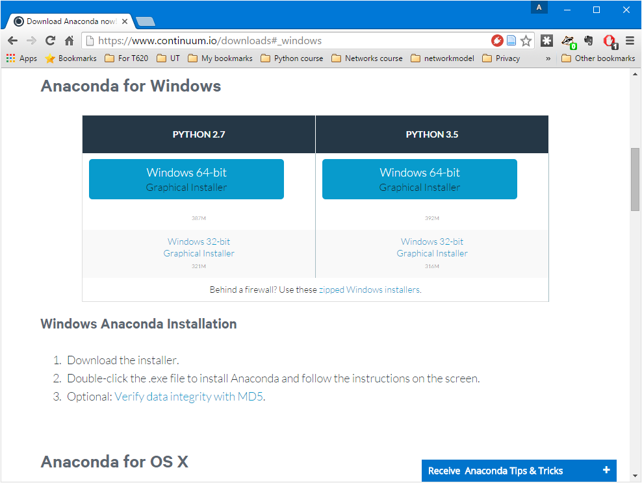
How to create Python notebooks
First, install Python (search for anaconda python)

Slide 34
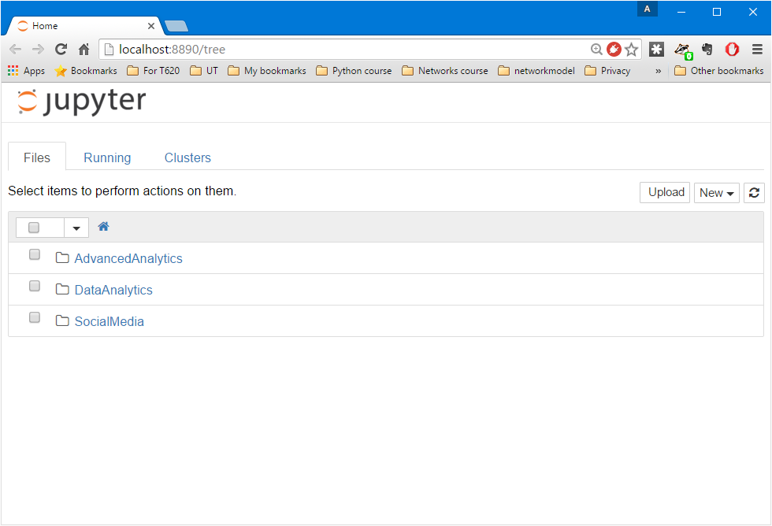
How to create Python notebooks
On the command-line, run:
ipython notebook

Slide 35
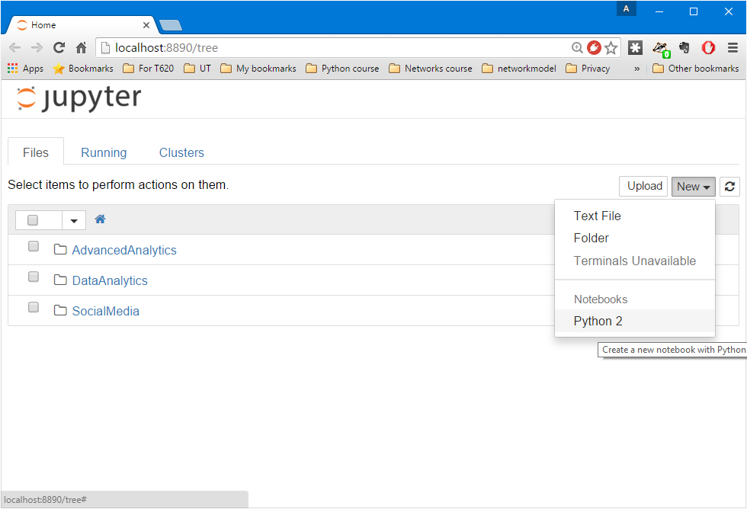
How to create Python notebooks
On the command-line, run:
ipython notebook

Slide 36
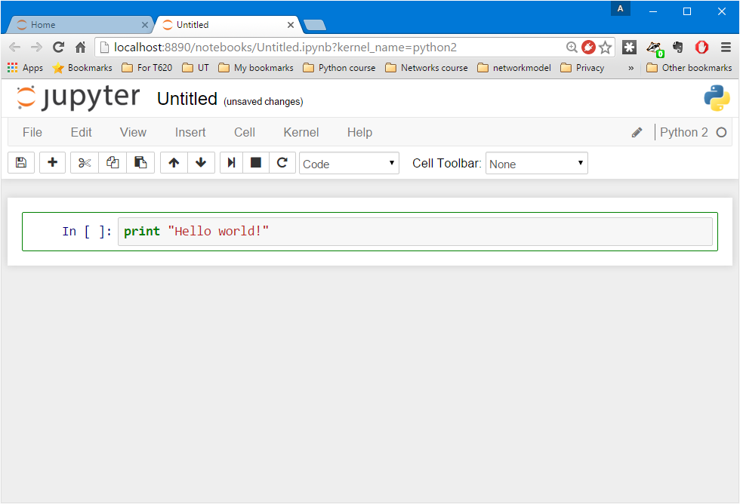
How to create Python notebooks
Change the name of the notebook
Write some code here; then hit Alt-Enter

Slide 37
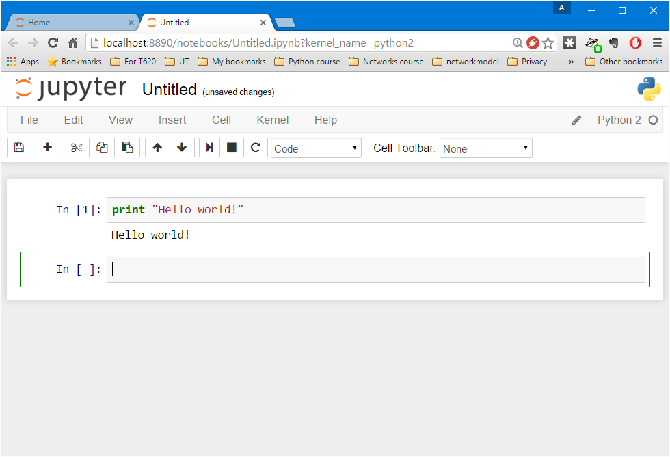
How to create Python notebooks
Change the cell type to “Markdown”
Output of the code
New cell

Slide 38
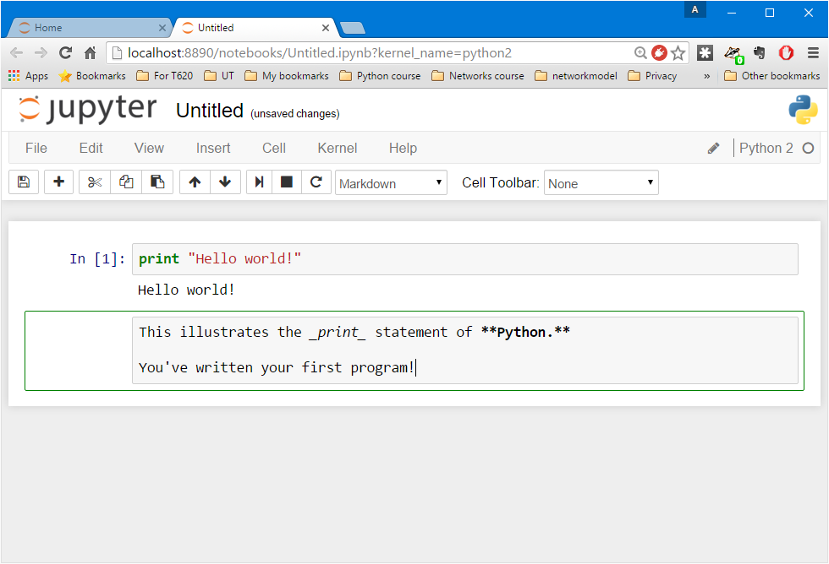
How to create Python notebooks
This cell is now interpreted as “Markdown”, which is text with
_italics_
**bold**
and many other options
Again, hit Alt-Enter

Slide 39
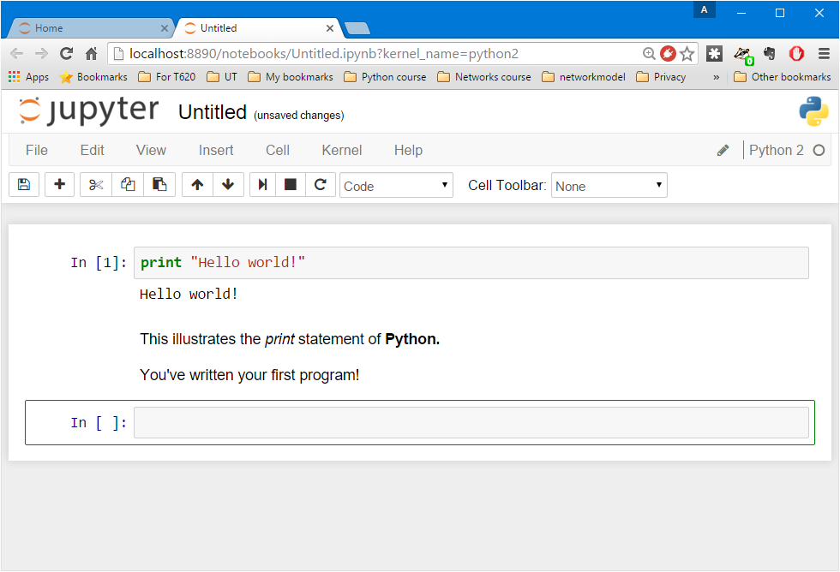
How to create Python notebooks
The Markdown cell gets converted into italicized and bolded text

Slide 40
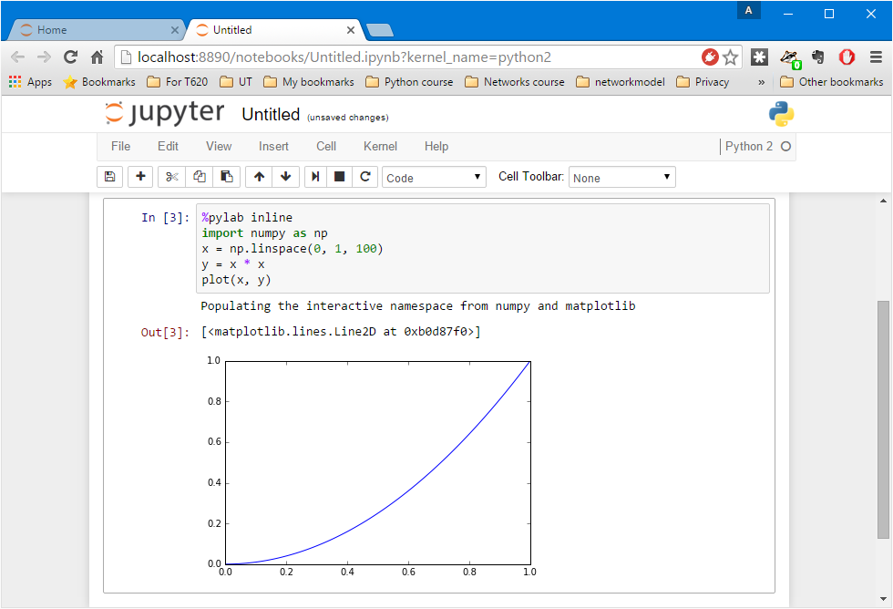
How to create Python notebooks
Save when you’re done!
Figures generated by your code are easily shown

Slide 41
One final bit of advice
This is not a course in Python programming
We learn Python so as to get to the good stuff
Analysis
Visualization
Data mining and machine learning
I cannot teach you all of Python
When in doubt,
read online tutorials
ask Google ☺

